Slide 1
Employee Data Analysis using Excel
STUDENT NAME: DHANASHREE.K
REGISTER NO : 312209189
DEPARTMENT : B.COM BANK MANAGEMENT
COLLEGE : ANNA ADARSH COLLEGE FOR WOMEN

Slide 2
PROJECT TITLE
Employee Performance Analysis using Excel

Slide 3


AGENDA
Problem Statement
Project Overview
End Users
Our Solution and Proposition
Dataset Description
Modelling Approach
Results and Discussion
Conclusion
3/21/2024 Annual Review

Slide 4

PROBLEM STATEMENT
To enhance the performance of employee.
Providing increment and promotion to employee for better performance of employees.
Motivating employee to work more
To check the regularity of the employee

Slide 5

PROJECT OVERVIEW
.
This ppt and Excel show the analysis of employees. It shows the all the data of employee,such as performance, role, Department and more. It make the process easier to analysis the data of all the employees.

Slide 6
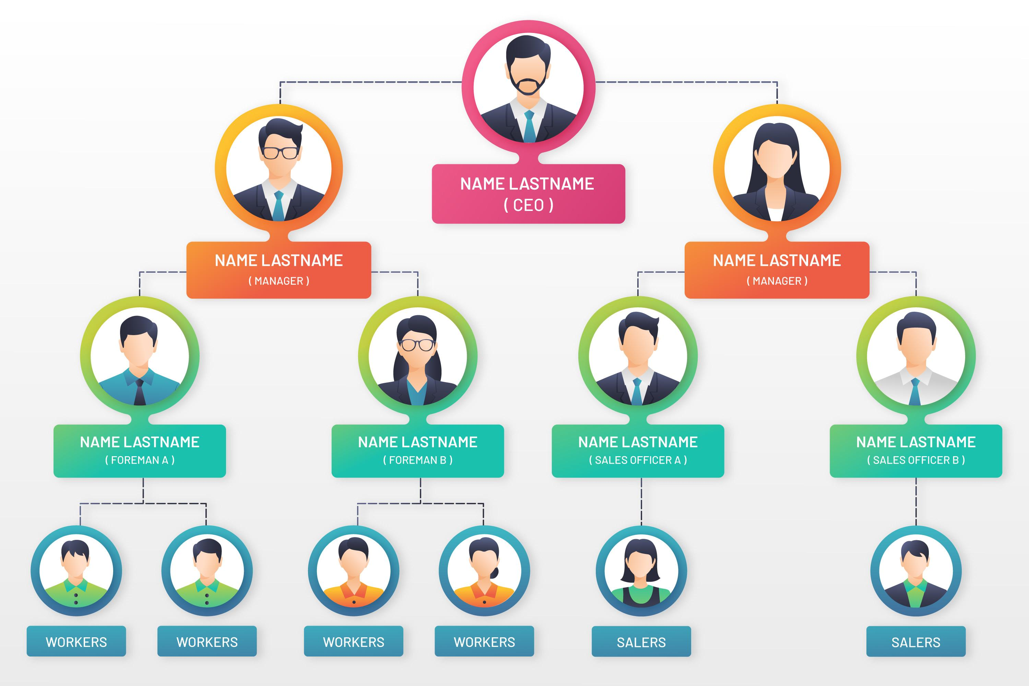

WHO ARE THE END USERS?

Slide 7

OUR SOLUTION AND ITS VALUE PROPOSITION
Conditional formatting –missing
Filter –remove
Formula –performance
Pivot –summary
Graph-data visualization

Slide 8
Dataset Description
Employee=Kaggle
26-feature
9-feature
Employee type
Department
Division
Pay zone
Job function
Location
Race des
Marital des
Employee rating
Performance level

Slide 9

THE "WOW" IN OUR SOLUTION
Performance level=IFS(Z8>=5 Very high,Z8>=4"HIGH",Z8>=3,"MED",TRUE,"LOW")
3/21/2024 Annual Review

Slide 10
MODELLING
Data collection
collection of data set from edunet dashboard includes the following
Employee name.
Employee ID.
Job function.
Feature
Highlighting the Important data by filling color.
Data cleaning
Filter the blank cell
Remove the blank cell by using conditional formatting
Performance level
It is calculated by using a formula
Performance level=IFS(Z8>=5 Very high,Z8>=4"HIGH",Z8>=3,"MED",TRUE,"LOW")
Summary
Result is shown in pie chart and graph.

Slide 11
RESULTS

Slide 12
RESULTS

Slide 13
conclusion
The overall analysis show the performance of employee, it show all the data of an employee
Such as employee gender,location,marital status, job function etc. It compare the employee by employee rating, it helps to identify were the employee are lacking in their field.And help to improve their work.

